Slide 1
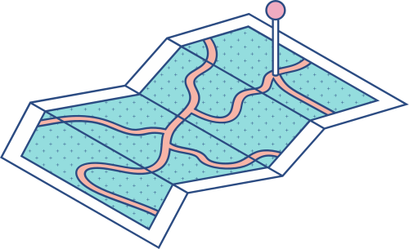





EMPLOYEE PERFORMANCE ANALYSIS USING EXCEL
STUDENT NAME: V.V.JEEVIKA
REGISTRATION NO: 312209481
DEPARTMENT: B.Com Bank Management
COLLEGE: ANNA ADARSH COLLEGE FOR WOMEN

Slide 2

PROJECT TITLE:
Employee Performance Analysis using Excel

Slide 3




AGENDA
Problem Statement
Project Overview
End Users
Our Solution and Proposition
Dataset Description
Modelling Approach
Results and Discussion
Conclusion

Slide 4




PROBLEM STATEMENT
To evaluate employee performance over the past year by identifying strengths, areas for improvement, and emerging trends. This analysis will provide insights to inform and enhance strategic HR decisions and planning.

Slide 5

PROJECT OVERVIEW
OBJECTIVE: ANALYZE AND VISUALIZE EMPLOYEE PERFORMANCE DATA TO UNCOVER TRENDS, STRENGTHS, AND AREAS FOR IMPROVEMENT, AIDING IN DECISION-MAKING FOR EMPLOYEE DEVELOPMENT AND RESOURCE ALLOCATION.
Data Types: Numeric (e.g., EmpID), categorical (e.g., Current Employee Rating), and textual (e.g., Employee performance level).
Data Cleaning: Address duplicates, manage missing values, and correct inconsistencies.
Data Organization: Arrange data in a tabular format with columns such as EmpID, First Name, Business Type, Gender Code, and Current Employee Rating.
Charts and Graphs: Generate bar charts to illustrate performance metrics.
Dashboards: Create interactive dashboards using Excel’s PivotTables and Pivot Charts for a dynamic performance overview.
Summary Report: Compile a report featuring key findings, visualizations, and actionable insights.

Slide 6





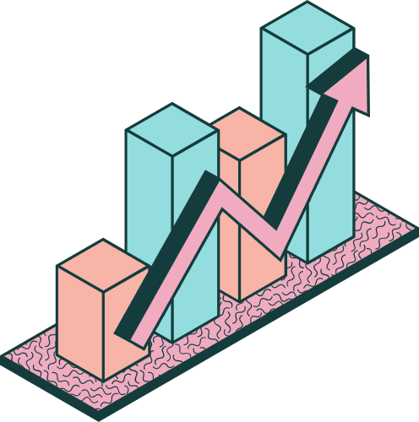


WHO ARE THE END USERS
Directors,Managers & Supervisors
1
2
HR Professionals
3
Executives
Training & Development Specialist
4
Compensation & Benefits Team
5
Recruiters & Talent Acquisition
6
7
Organizational Development Consultants

Slide 7


OUR SOLUTION AND ITS VALUE PROPOSITION
CONDITIONAL FORMATTING: APPLIED FOR MISSING VALUE
Filter: Remove missing value
Formula: Performance Metrics
Pivot: Summary Overview
Graph: Data Visualization

Slide 8
DATASET DESCRIPTION
DATASET SOURCE: KAGGLE
TOTAL NUMBER OF FEATURES: 26
NUmber of Features Used: 9
EmpID: Numeric data
First Name: Textual data
Last Name: Textual data
Business Unit: Textual data
Employee Status: Textual data
Employee Type: Textual data
Gender Code: Textual data
Current Employee Rating: Categorical data
Performance Level: Textual data

Slide 9
THE "WOW" IN OUR SOLUTION
Interactive Dashboards: Design dynamic dashboards using Excel’s PivotTables, slicers, and interactive charts. These tools enable stakeholders to effortlessly explore data, filtering by departments, time periods, or performance categories with just a click.
Employee Growth Trajectory Visualization: Create performance trend lines and growth trajectory charts for employees to illustrate their development over time. These visualizations not only motivate employees but also provide managers with a clear view of long-term performance.
The ‘WOW’ Factor: The "WOW" of this solution is its capability to convert raw data into insightful, actionable, and interactive performance analysis. It empowers decision-makers, boosts employee engagement, and fosters continuous improvement throughout the organization. By leveraging advanced visualizations, automation, and predictive features, this solution elevates Excel from a basic tool to an advanced performance management platform. included =IFS(Z2>=5,"VERY HIGH",Z2>=4,"HIGH",Z2>=3,"MED",TRUE,"LOW") to make the anlysis in a more efficient way .

Slide 10
MODELING
1. Data Collection and Organization
Data Sources: Collect data from kaggle.
Fearture Collection: Organize the data in Excel with the following columns (as an example):
EmpID
First Name
Last Name
Business unit
Employee Status
Employee type
Gender code
Current Employee Rating
Performance level
This data should be laid out in a structured table for ease of analysis.
2.Data cleaning
Identifying Missing Data: Uscel functions to finding the missing data by using conditional formatting .
Filter: Use excel functions to filter the missing data using the filter option .

Slide 11
MODELING
3.Performance Level
Using the given data we use “current employment rating “ as that base a base we create performance level using the formula =IFS(Z2>=5,"VERY HIGH",Z2>=4,"HIGH",Z2>=3,"MED",TRUE,"LOW") we are able to create the performace level by categories them from highest to lowest.
4. Data Visualization
PivotTables and PivotCharts: Create PivotTables to summarize data by department, job role, or time period. PivotCharts can visualize these summaries in bar charts
Trend Analysis: Use line charts to visualize performance level.

Slide 12

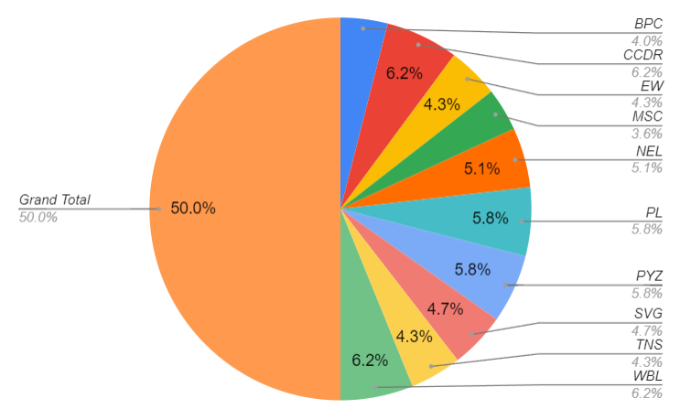
RESULTS

Slide 13
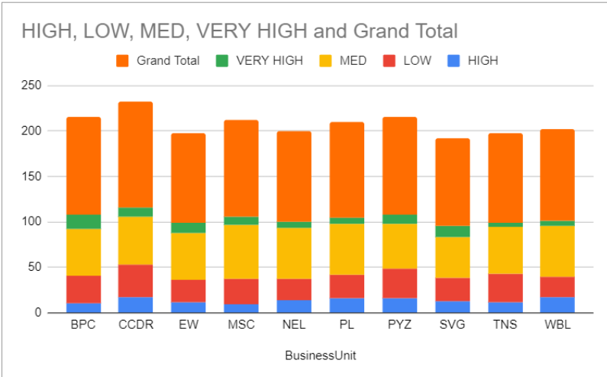
RESULTS

Slide 14



CONCLUSION
In summary, effective employee performance analysis are essential to improve individual and organizational outcomes. By using tools like Excel, organizations can gain actionable insights that drive appropriate decisions on promotion, training, and compensation This program is not areas of excellence are not only areas of improvement but also align employee goals with organizational objectives, leading to greater productivity and employee engagement. Regularly updating the inspection system will ensure that it remains relevant and effective.

